Slide 1
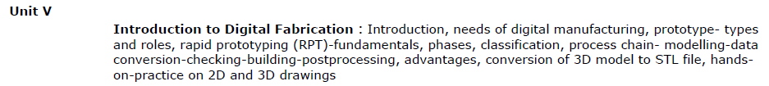
Unit 5
Introduction to Digital Fabrication

Slide 2
Content
Need of digital manufacturing
Prototype
Types and roles of prototypes
Rapid prototyping (RPT)
Phases of RPT
Fundamentals of RPT and Advantages

Slide 3
Digital Fabrication
Digital fabrication is a design and manufacturing workflow where digital data directly drives manufacturing equipment to form various part geometries.
This data most often comes from CAD (computer-aided design), which is then transferred to CAM (computer-aided manufacturing) software.
The output of CAM software is data that directs a specific additive and subtractive manufacturing tool, such as a 3D printer or CNC milling machine.
Case study: https://www.computerscience.org/resources/3d-printing/

Slide 4
Video: What is digital manufacturing
https://www.youtube.com/watch?v=s4HPs-aXOe4

Slide 5
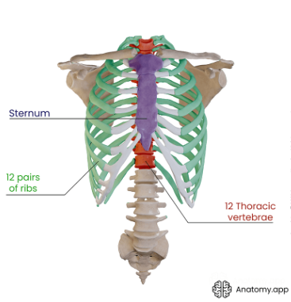
3D Printing
Case study: https://www.computerscience.org/resources/3d-printing/
In September 2015, a 54-year-old cancer patient became the first human to receive a 3D printed implant — a custom-designed rib cage to replace his sternum and pieces of four ribs severely damaged when doctors removed a large tumor. The prosthetic sternum has four thin, flexible rods that bend the same way ribs would during breathing. It was made entirely from titanium, using a $1.3 million metal printer at a government-run lab. The complex prosthetic would have been almost impossible to manufacture through traditional means. From manufacturing to medicine, food to fashion, and electronics to education, 3D printing is reshaping and revolutionizing the way products are developed and produced.
3D printing has been used in dentistry to create custom-designed teeth, bridges and crowns. With advances in materials and processes, it’s possible that dentists will soon be able to produce personalized, 3D printed teeth in their offices, in as little as ten minutes.
3D printed houses

Slide 6
Computer Science & 3D Printing
Software Development
One of the biggest concerns in the 3D printing industry is the need for better and, perhaps most importantly, more user-friendly software to design and manufacture 3D printing products. As a result, the industry has become a top destination for software development professionals. Software developers in this field will write code to help improve 3D printing products as well as work cross-functionally with various teams.
Computer Programmer
3D printing relies on skills and knowledge in science, technology, engineering, and math (as well as art), making computer programming another solid option for students interested in the field. These professionals use their expertise to write programs that produce solid structures of all shapes and sizes.
Educator
As the 3D printing industry expands, colleges and universities are seeking teachers with specific knowledge and experience with 3D printing systems to train future professionals. 3D printing educators may also be employed by private manufacturers to develop courses or workshops dedicated to 3D printing and related technology.

Slide 7
Top Companies using 3D Printing
Airbus
The company boasts that 3D printing has resulted in lighter parts, which requires less time and fewer materials to produce, with a corresponding drop in the environmental impact. Airbus recently announced that more than 1,000 parts used in the construction of its new A350 XWB aircraft are 3D printed.
Ford Motor Company
Ford has 3D printed over 500,000 parts, a move the company estimates has saved billions of dollars and millions of work hours
General Electric
The corporate powerhouse, General Electric, is a leading manufacturer of jet aircraft engines. GE Aviation claims that it will produce more than 100,000 parts by the close of the decade.

Slide 8
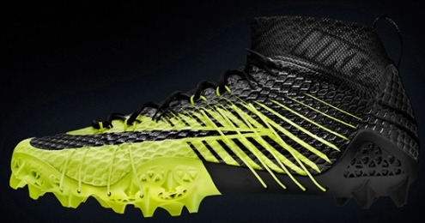
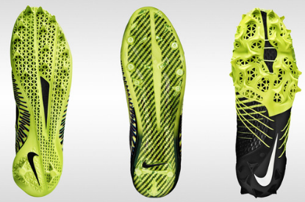
Nike
Nike is a world leader in the sports apparel industry, particularly when it comes to shoes. What may not be known is that Nike is also a leader in the use of 3D printing in its shoe design and manufacturing processes. A prime example is Nike’s Vapor Hyper Agility Cleat, which combines 3D knitting with 3D shoe printing, one of three Nike cleats that employs 3D printing technology in its production.
Nike’s Vapor Hyper Agility Cleat

Slide 9
Adidas’ First Mass Market 3D-Printed Shoe
https://www.youtube.com/watch?v=qlomslovAnI

Slide 10
How 3D Printing works?
The 3D printing process, in basic terms, includes the following steps:
The manufacturer creates a digital model of the object to be produced, normally by using a computer-aided design (CAD) program and employing some form of 3D scanning.
The CAD model is converted into an appropriate file format, such as STL (stereolithography).
The STL file is transferred to the computer that directly controls the 3D printer (a process similar to transferring a file to a standard printer when printing a document).
The 3D printer is readied for the job. Containers are loaded with the appropriate printing materials (polymers and binders, for example), and a foundation tray for the finished object is set up.
The printer builds the object, layer by layer. This process can take hours, or even days, depending on the size and complexity of the object and the materials used to create it.
Once the 3D printer has completed the building process, the object is removed from the machine. The object may require some post-manufacturing actions, such as brushing and polishing, as well as the removal of water-soluble supports. The object may also require time to cure before it can be used.

Slide 11
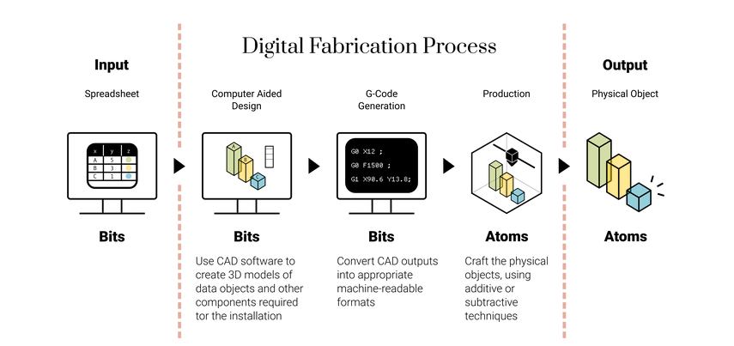
Digital Fabrication Process

Slide 12
Need of digital manufacturing
Keep it in-house – With a 3D printer and the right software, you can produce small batches of products on your own premises without the need for external vendors
Easy to test – Have an idea? With digital fabrication, you can bring it to life and see if it’s feasible. It helps you gain valuable insight into your customer needs, the marketplace and anything else that can spell the difference between success and failure
Save money – Because you’re only making prototypes or small batches of a product, you won’t need much storage space. You can also save money on materials by using lower-grade supplies or even recycled plastic
Save time – Digital fabrication accelerates the process of product development as you can create prototypes much more quickly than traditional manufacturing methods, with no need to outsource
Spot errors early – Engineers like digital fabrication because it helps them spot any issues that exist within days rather than months

Slide 13
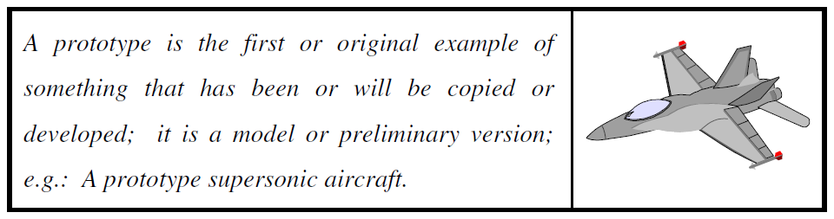

Prototype
The definition of prototype as per the Oxford Advanced Learner’s Dictionary
General definition

Slide 14
Types of Prototype
The general definition of the prototype contains three aspects of
interests:
The implementation of the prototype; from the entire product (or system) itself to its sub-assemblies and components. E.g. Testing of an office chair for comfort
The form of the prototype; from a virtual prototype to a physical prototype. E.g. Mathematical models for visualization of airflow over an aircraft wing to ascertain lift and drag on the wing, Dummy mobile
The degree of the approximation of the prototype; from a very rough representation to an exact replication of the product.

Slide 15
Roles of the Prototypes
The roles that prototypes play in the product development process are several. They include the following:
(1) Experimentation and learning. E.g. Elbow rest of a Chair
(2) Testing and proofing.
(3) Communication and interaction. E.g. Dummy mobiles
(4) Synthesis and integration. E.g. Clutch
(5) Scheduling and markers. E.g. Building models

Slide 16
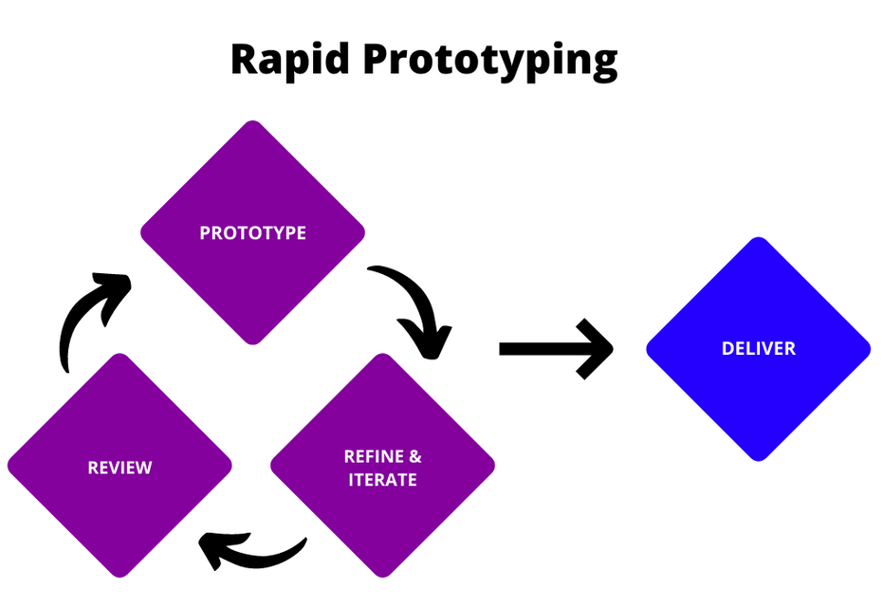
Rapid Prototyping
Rapid prototyping is a group of techniques used to quickly fabricate a scale model of a physical part or assembly using three-dimensional computer aided design data.
“As the name implies, rapid prototyping is a process of creating a prototype rapidly to evaluate the features or some part of the product.”

Slide 17
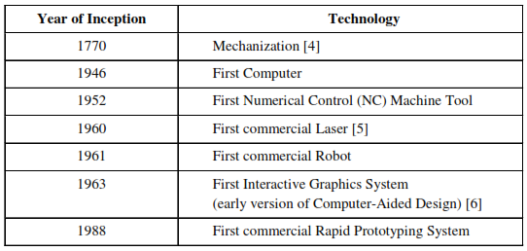
Historical development of Rapid Prototyping

Slide 18


Phases of Rapid Prototyping
Phase 1
Manual Prototyping
Phase 2
Soft or Virtual Prototyping
Phase 3
Rapid Prototyping

Slide 19
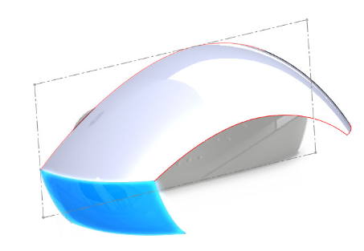
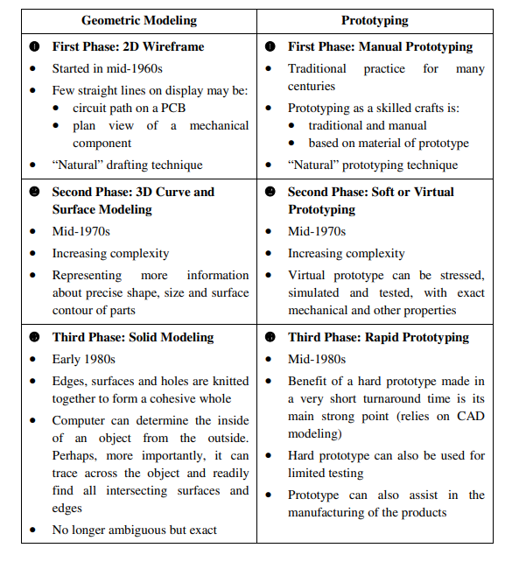
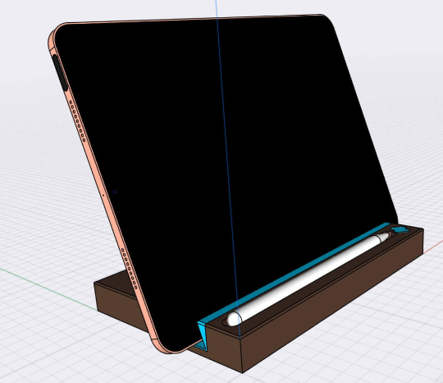
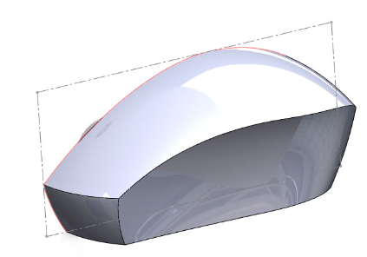
Difference between geometric modeling and prototyping
Solid Modelling
Surface Modelling

Slide 20
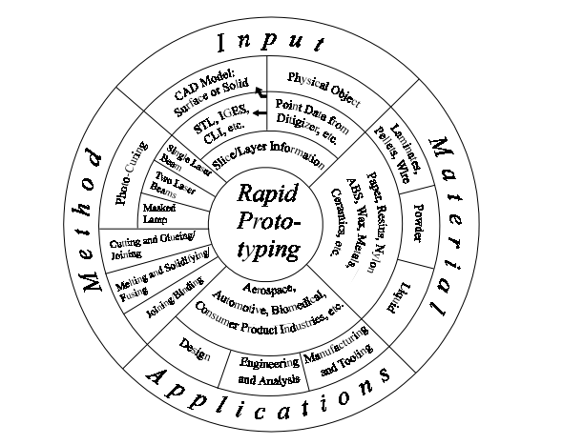


Fundamentals of Rapid Prototyping
Fundamentally, the development of RP can be seen in four primary areas.
Rapid Prototyping
Input
Method
Material
Application

Slide 21
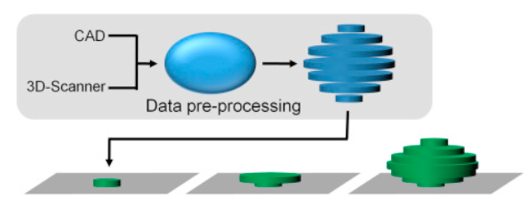
Fundamentals of Rapid Prototyping
Rapid Prototyping
Input
Method
Material
Application

Slide 22
Advantages of Rapid Prototyping
Advantages of Rapid Prototyping
Direct Benefits
Benefits to Product Designers
Benefits to tooling and Manufacturing Engg
Indirect Benefits
Benefits to Marketers
Benefits to Consumers

Slide 23
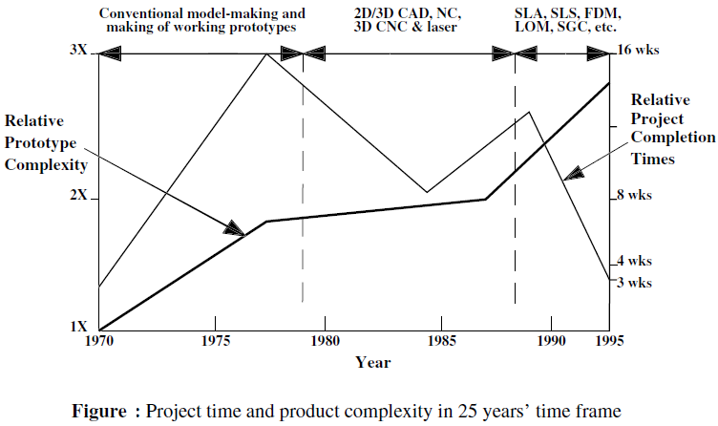
Advantages of Rapid Prototyping

Slide 24
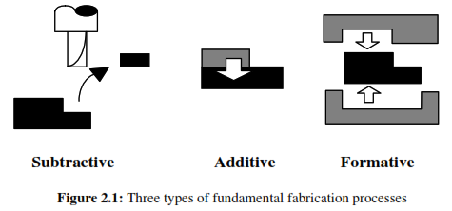
FUNDAMENTAL AUTOMATED PROCESSES

Slide 25
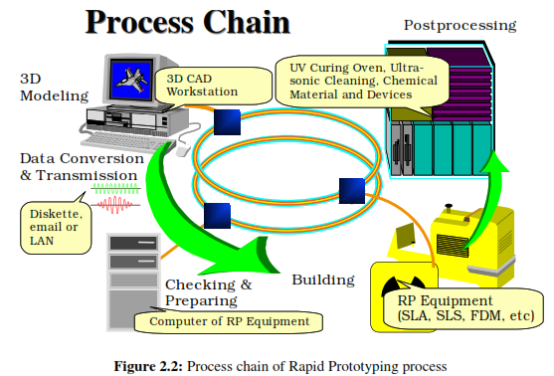
RAPID PROTOTYPING PROCESS CHAIN

Slide 26
CLASSIFICATION OF RAPID PROTOTYPING
SYSTEMS
1. Liquid based
Stereolithography Apparatus (SLA)
Solid Object Ultraviolet-Laser Printer (SOUP)
2. Solid based
  Laminated Object Manufacturing (LOM)
  Fused Deposition Modeling (FDM)
3. Powder base
Selective Laser Sintering (SLS)

Slide 27
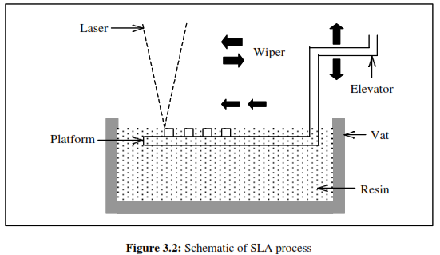
Stereolithography Apparatus (SLA)
Most liquid-based rapid prototyping systems build parts in a vat of photo-curable liquid resin, an organic resin that cures or solidifies under the effect of exposure to laser radiation, usually in the UV range.
The laser cures the resin near the surface, forming a hardened layer.
When a layer of the part is formed, it is lowered by an elevation control system to allow the next layer of resin to be similarly formed over it.
This continues until the entire part is completed.
Video: https://www.youtube.com/watch?v=yW4EbCWaJHE

Slide 28
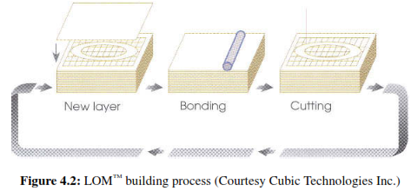
Laminated Object Manufacturing (LOM)
Parts are built, layer-by-layer, by laminating each layer of paper or other sheet-form materials and the contour of the part is cut by a CO2 laser.
The next layer is then laminated and built directly on top of the laser-cut layer.
The Z-control is activated by an elevation platform, which lowers when each layer is completed, and the next layer is then laminated and ready for cutting.
No additional support structures are necessary as the “excess” material, which are cross-hatched for later removal, act as the support.
Video: https://www.youtube.com/watch?v=GUvnz0borAI

Slide 29
Fused Deposition Modeling (FDM)
The principle of the FDM is based on surface chemistry, thermal energy, and layer manufacturing technology.
The material in filament(spool) form is melted in a specially designed head, which extrudes on the model.
As it is extruded, it is cooled and thus solidifies to form the model.
The model is built layer by layer, like the other RP systems.

Slide 30
Selective Laser Sintering (SLS)
A thin layer of heat-fusible powder is deposited onto the part building chamber.
The bottom-most cross-sectional slice of the CAD part under fabrication is selectively “drawn” (or scanned) on the layer of powder by a heat-generating CO2 laser.
The interaction of the laser beam with the powder elevates the temperature to the point of melting, fusing the powder particles to form a solid mass.
When the cross-section is completely drawn, an additional layer of powder is deposited via a roller mechanism on top of the previously scanned layer. This prepares the next layer for scanning.
Video: https://www.youtube.com/watch?v=ruvRijM7f50

Slide 31
Thanks

